Slide 1




WELCOME TO CIVICS
Ms. Nicol Gonzalez
Ngonzalez@somersetacademysh.com
Room 220
Civics/Civics ADV

Slide 2

Attendance
Please arrive to class on time and ready to start
3 tardies will be marked as a zero for classwork that day
All classwork is due on the assigned
If you are absent and it is "excused" you will have 2 days to make-up assignments
You will be responsible for attending class every day on time

Slide 3
Assignments
All Assignments will have a due date.
All assignments will be turned in either in bins located at the left of classroom or via Google Classroom.
All quizzes will be taken on Google Classroom or Study Island.
Quizzes cannot be made-up. You will have to complete an alternative assignment in order to make up any quiz grades.

Slide 4
Course Expectations
Course Expectations:
There will be a major assignment due every 2 weeks whether it be a test, report, or a project. All students will be given 2 additional days to make up a major assignment if late (with a progressive grade penalty of 5 points per day).
Students with an excused absence from school will have the opportunity to make up missing work at the rate of one day for one day missed, with a maximum of five days. Students who are absent but had prior notice of a major assignment must complete the assignment on the first day back to school. Students will receive a zero for any major or minor assignment not made up within the allotted time.
Statement for Academic Dishonesty: Academic integrity is fundamental to the activities and principles of our school. No student shall cheat or copy the work of another. Plagiarism; the use of another person's original ideas or writings as one's own without giving credit to the true author, will be considered cheating and the student will be subject to academic discipline that may include loss of credit for the work in question.
Homework Policy:
Homework will be given Monday through Thursday. Students will be required to read 20 minutes each night in addition to 25 minutes of other assigned homework on Study Island

Slide 5

Grading:
Grading Policy:
A=90-100
B=80-89
C=70-79
D=60-69
F=0-59
Grading Scale:
The grading scale is as follows:
Students will be assessed in the following areas: classwork (5%), homework (5%), quizzes (20%), projects (15%), online components (15%), and tests (40%).

Slide 6
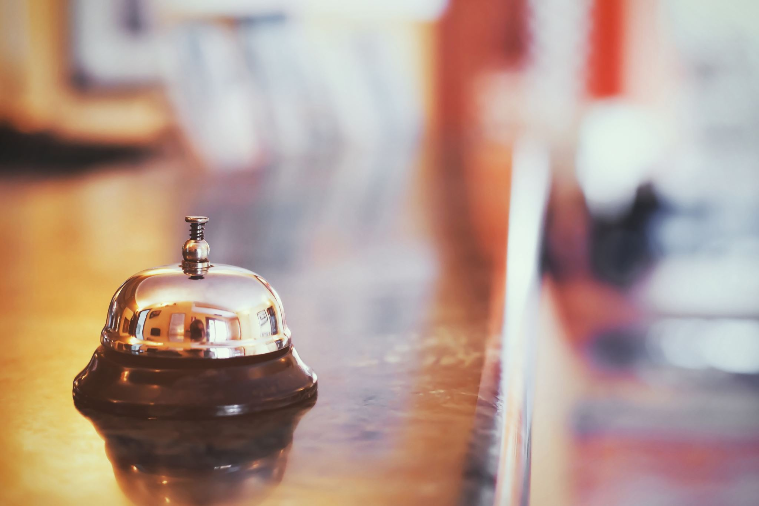
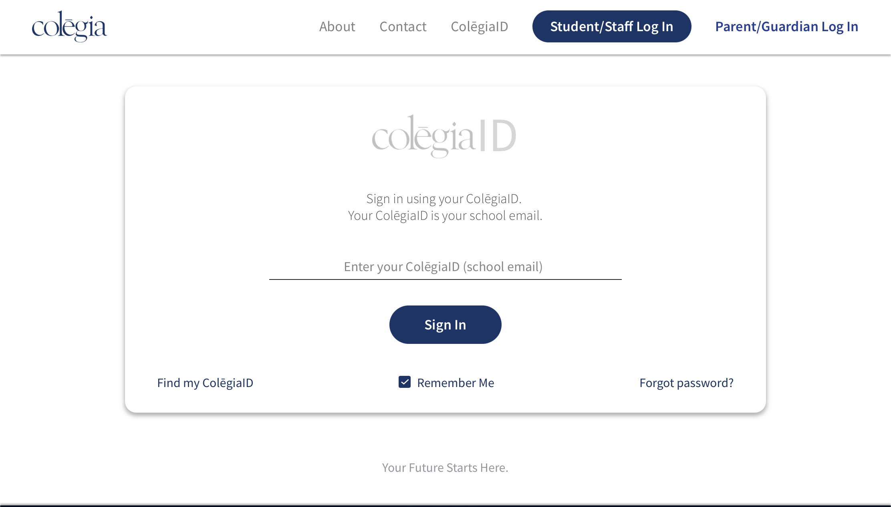


Colegia website: colegia.org click on Student/Staff Login
Type in Somerset email and click sign in

Slide 7

Bell Schedule
7:00 am –7:30 am Student Arrival
7:30 am –8:00 am High School Advisement(Students must be seated by 7:45am)
8:00 am –8:50 am PERIOD 1(daily)
8:54 am –10:24 am PERIOD2/3
10:28 am –1:11 pm PERIOD4/5(including lunch
**FOCUS takes place on Tues./Wed./Fri.**
10:28 am –11:28 am High School FOCUS
12:11 pm –1:11 pm Middle School FOCUS
1:15 pm –2:45 pm PERIOD6/7
2:45 pm –3:15 pm Middle School Advisement(dismissal begins at 3:00pm)

Slide 8
Lunch Schedule
Monday-Friday
1st Lunch 10:28 am –11:03 am
2nd Lunch 11:11 am –11:46 am ** Both A & B Days
TABLE 8
3rd Lunch 11:54 am –12:29 pm
4th Lunch 12:36 pm –1:11 pm

Slide 9
Classroom Rules
CLASSROOM NORMS/EXPECTATIONS: What Works for Me
EVERYONE WILL HAVE ASSIGNED SEATS.
RESPECT—Respect others, their property, and their right to learn. Students are expected to treat other classmates and the teacher with respect and courtesy.
RESPONSIBILITY—Come to class every day with the required materials. Be prepared and ready to participate. If you are absent from class, you are responsible for your make-up work. I will not hunt you down.
BELL-TO-BELL—Be seated and on task when the bell rings and wait for me to dismiss you (not the bell) at the end of the period.
ASSIGNMENTS—Assignments are due at the beginning of class. Please place in designated class period trays at-back of the room.
PROFANITY- NO profanity will be tolerated!
LEAVING THE ROOM—Visit the restroom, water fountain, etc., on your own time. If you must leave the room, first ask permission and passes will be given at teacher’s discretion.
CELL PHONES—See above information regarding “respect.” Unless I direct you to use them, they need to be put away in the bin provided or in your bookbag. Any phones out without permission will be confiscated and will be given back at the end of the class.

Slide 10
Disciplinary Plan
Offenses | Consequences
1 | Verbal Warning
2 | Behavior Notification , Parent Contact
3 | Grade Level Appropriate Essay , Behavior Notification , Detention Issued- Wednesday after school
4 | Detention Issued- to be held Saturday, Parent Contact
5 | Referral-sent to office Anything after will be dealt by administration and parents.
Disciplinary Plan:
Reference table that outlines each step of the disciplinary plan and its corresponding consequence.

Slide 11
Materials
Required Supplies:
5-Subject Notebook
Composition Book (Journal)
College-Ruled Paper
Blue/Black Ink Pens
Copy Paper (1 Ream per Student)
Bring you own Computers to class
Notebook:
You will be responsible for maintaining your Notebook throughout the year. The purpose of creating these notebooks is to help you organize your material and to make sure you have this material to study for unit and semester tests. It is your responsibility to keep your notebook up to date so that you can find your materials quickly and to be able to review prior to a test.

Slide 12
Remind
Remind is an app used to send you reminders about tests, quizzes, and homework.
Signing up for the class on Remind is REQUIRED!
You will receive a grade for signing up!
Codes will be posted in Class and on a Google Class Doc.
You can also communicate with me via email and direct message!

